Slide 3
Gospel Centered and Saturated
Book of Philippians is "all about the Gospel”
The word “gospel”
18x in Romans
9x in Philippians which is arguably at least 1/4 of the length
The major concept of the book of Philippians
Found in Chapter 1 verse 27

Slide 4
Phil 1:27
Only conduct yourselves in a manner worthy of the gospel of Christ

Slide 5
Phil 1:27
so that whether I come and see you or remain absent, I will hear of you that you are standing firm in one spirit, with one mind striving together for the faith of the gospel

Slide 6
Conduct as a Citizen
Your Life/Living
The GOSPEL

Slide 7
Balance it out

Slide 8
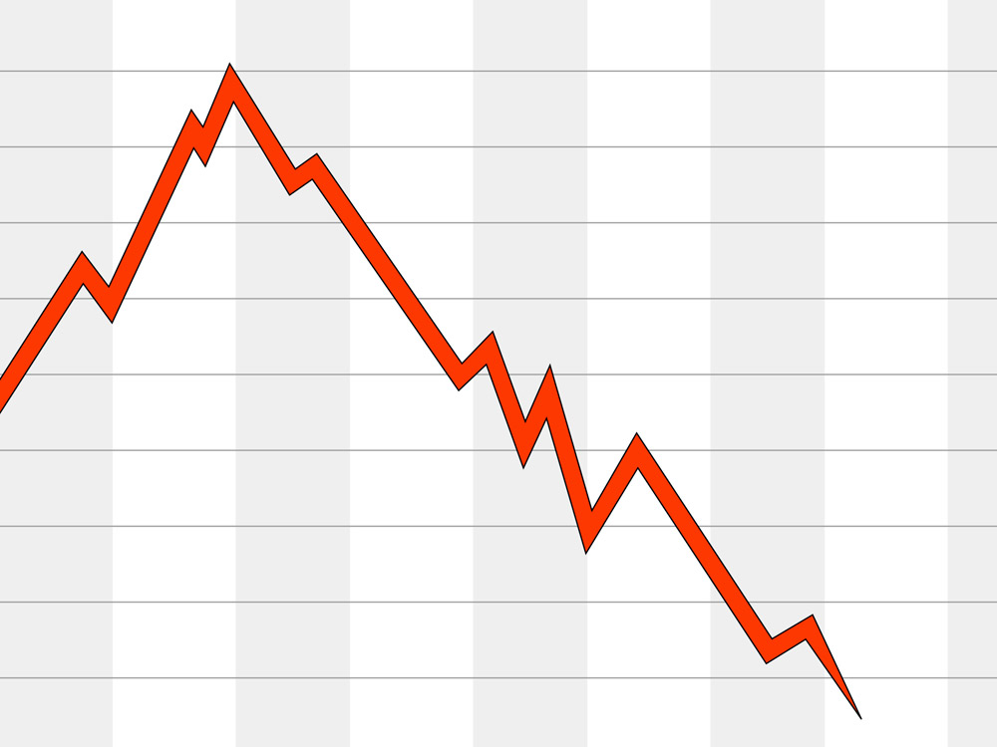

Slide 9
You, what you want, all you will ever become
The GOSPEL

Slide 10
This process have been observed in Western Christianity to proceed in 4 generations in the following way.
The gospel is accepted —>
The gospel is assumed —>
The gospel is confused —>
The gospel is lost.

Slide 12
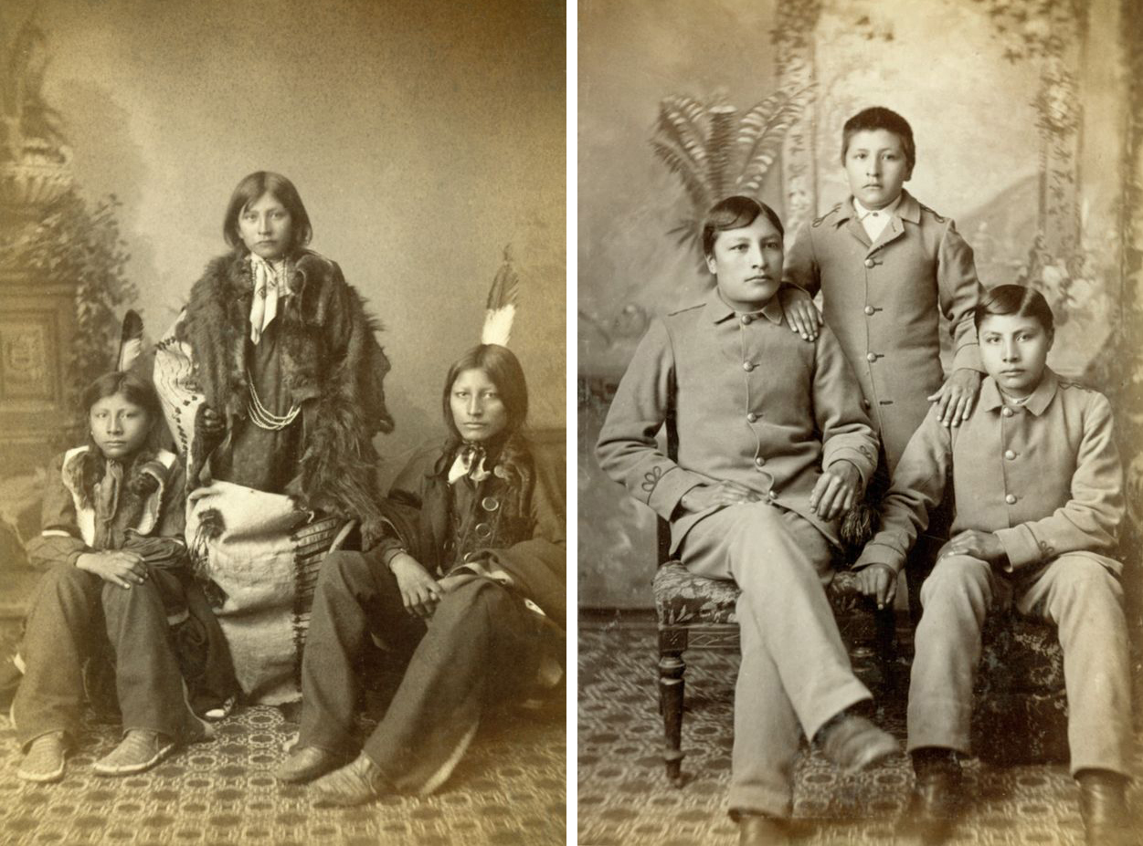

Slide 13
Do we even work at least as hard at maintaining or making progress in the Gospel as we do in

Slide 15
The GOSPEL
You and all you will every become

Slide 20
What is the Gospel?
It is news – good news (eu-angellion)
It is news about what God has done
It is news about what God has done for sinful men and women
It is news about what God has done for sinful men and women in and through the person of Jesus Christ, God the Son.

Slide 21
The Triune GOD
God the Son
God the Son
WAR
Created
GLORIFICATION
FAITH/BELIEVE/EMBRACE/TREASURE/SAVOR
The World and the Universe
The World and the Universe
Mankind
Mankind
God the Son
God the Son
God’s Wrath
God the Son
FAITH/BELIEVE/EMBRACE/TREASURE/SAVOR

Slide 22
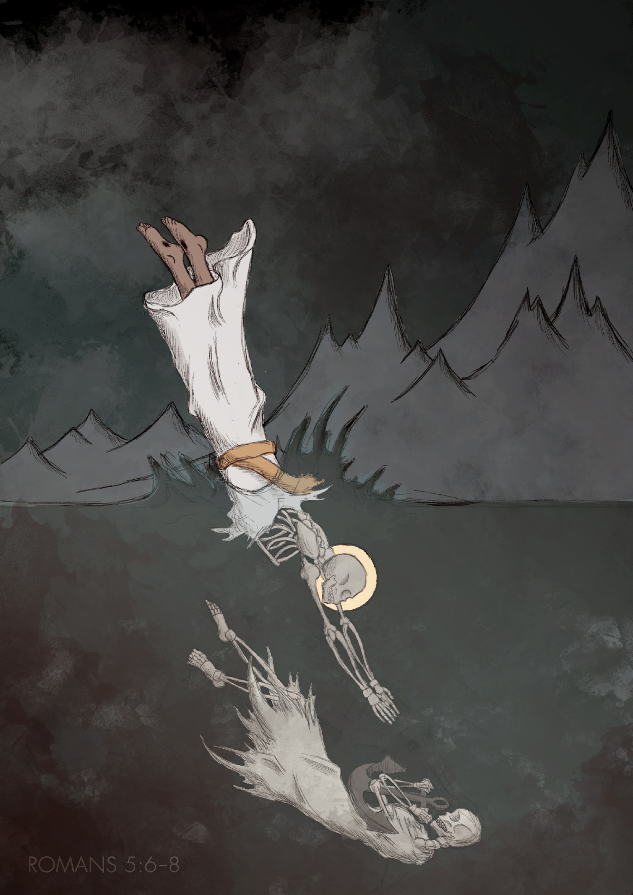
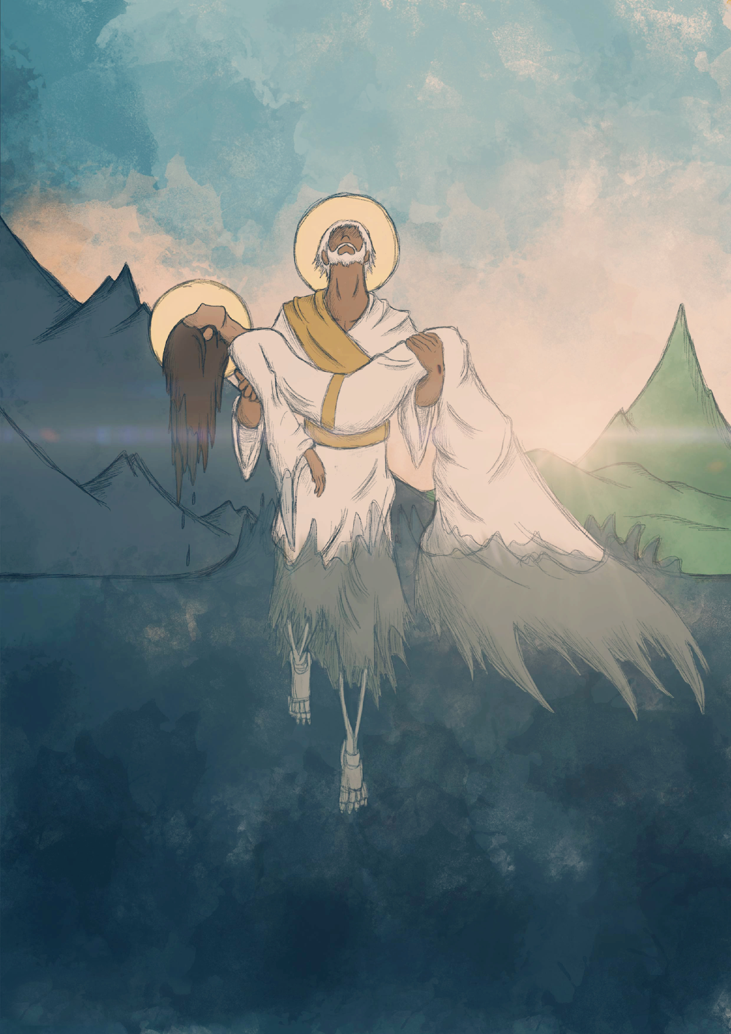
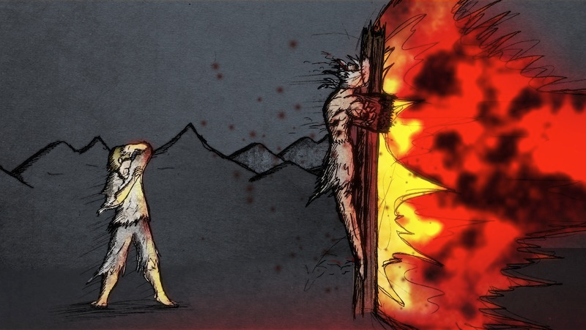

Slide 23
Balance it out

Slide 24
easy
to
hard to do

Slide 29
The Problem:
Losing the Gospel/ Losing our First Love
The History and Foundation of the Church at Philippi:
The Book of Acts
Lessons Learned from Examples in Acts 16
Displaying the Worth of the Gospel:
The Book of Philippians

Slide 30
Displaying the Worth of the Gospel
Joyfully trusting and obeying God and treasuring Christ over and against all else in every facet of your life.

Slide 31
Displaying the Worth of the Gospel
includes but is not limited to...
Trusting God Adventurously
Joyfully Receiving Course Corrections
Generously Meeting Needs Especially Eternal Needs
Receiving Bright Moments of God's Providence
Demonstrating Routine Faithfulness
Receiving Dark Moments of God's Providence
Suffering for the Sake of Christ
Giving of Yourself Sacrificially for the progress of the Gospel

Slide 32
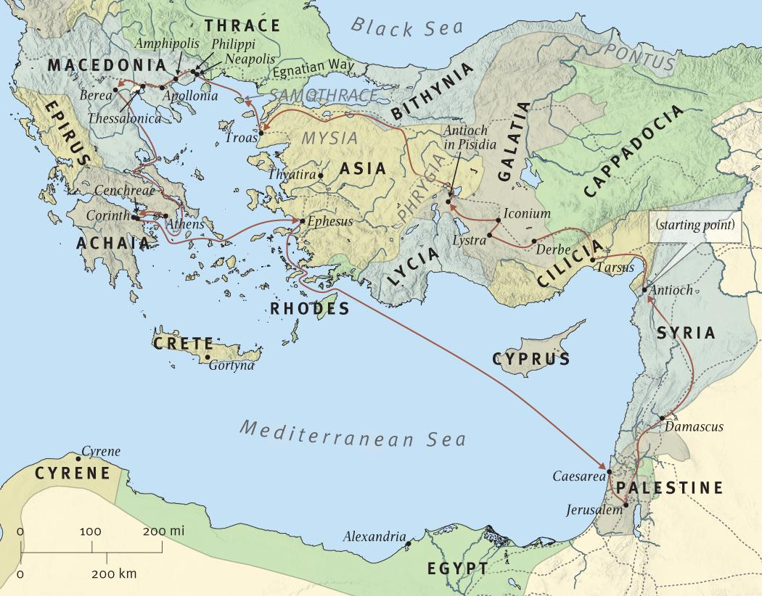
4
5
6
7
3
1
2

Slide 33
3
2
1
1

Slide 34
6
5
4
3
2
About 500 miles
1
1

Slide 35
Trusting God Adventurously
Paul displayed the worth of the Gospel, the worth of the Lord Jesus, by CONTINUING to embark on the adventure with the second missionary journey
Revisiting and strengthening the churches
New places, new cultures, new relationships, unknowns, might be’s, what if’s, I don’t know’s.
Not everything went according to plan.
Not everything went well
Some things went better than ever expected

Slide 36
Displaying the Worth of the Gospel
includes but is not limited to...
Trusting God adventurously
Geographically
Relationally
Personally

Slide 38
Displaying the Worth of the Gospel
includes but is not limited to...
Trusting God Adventurously
Joyfully Receiving Course Corrections

Slide 39
4
3
2
6 They passed through the Phrygian and Galatian region, having been forbidden by the Holy Spirit to speak the word in Asia;
1
1

Slide 40
6
5
4
3
2
7 and after they came to Mysia, they were trying to go into Bithynia, and the Spirit of Jesus did not permit them; 8 and passing by Mysia, they came down to Troas.
1
1

Slide 41
Displaying the Worth of the Gospel
includes but is not limited to...
Joyfully Receiving Course Corrections
As you mature in Christ, and more and more display the worth of the Gospel
You will not only make choices between good and bad, sin and righteousness, wickedness, and obedience, BUT
You will also make choices between better and best, good and excellent
You will also rest and trust in the inscrutable wisdom and sovereign goodness of your God.

Slide 42
Displaying the Worth of the Gospel
includes but is not limited to...
Trusting God Adventurously
Joyfully Receiving Course Corrections
Generously Meeting Needs Especially Eternal Needs

Slide 43
9 A vision appeared to Paul in the night: a man of Macedonia was standing and appealing to him, and saying, “Come over to Macedonia and help us.”

Slide 45
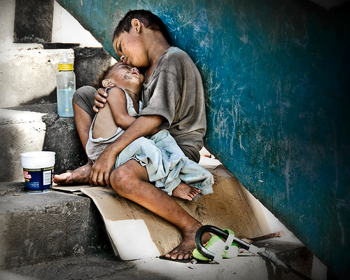
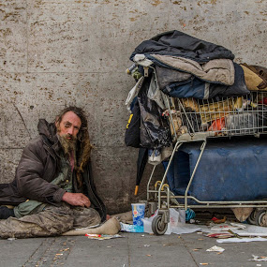
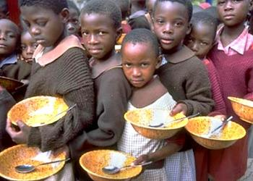
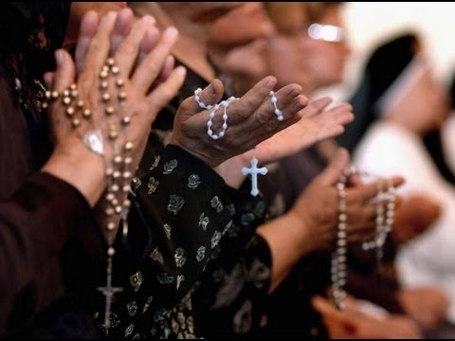
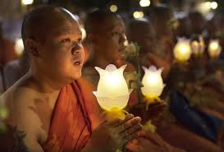
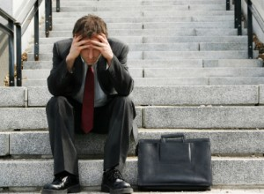
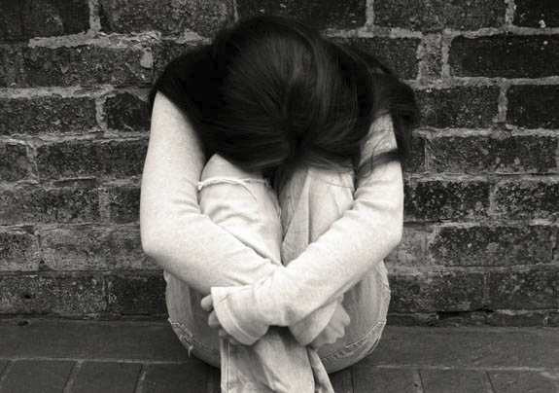
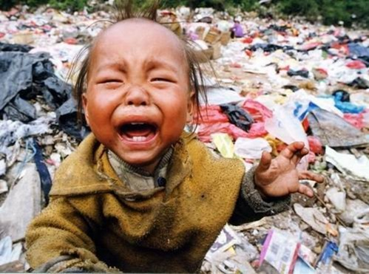
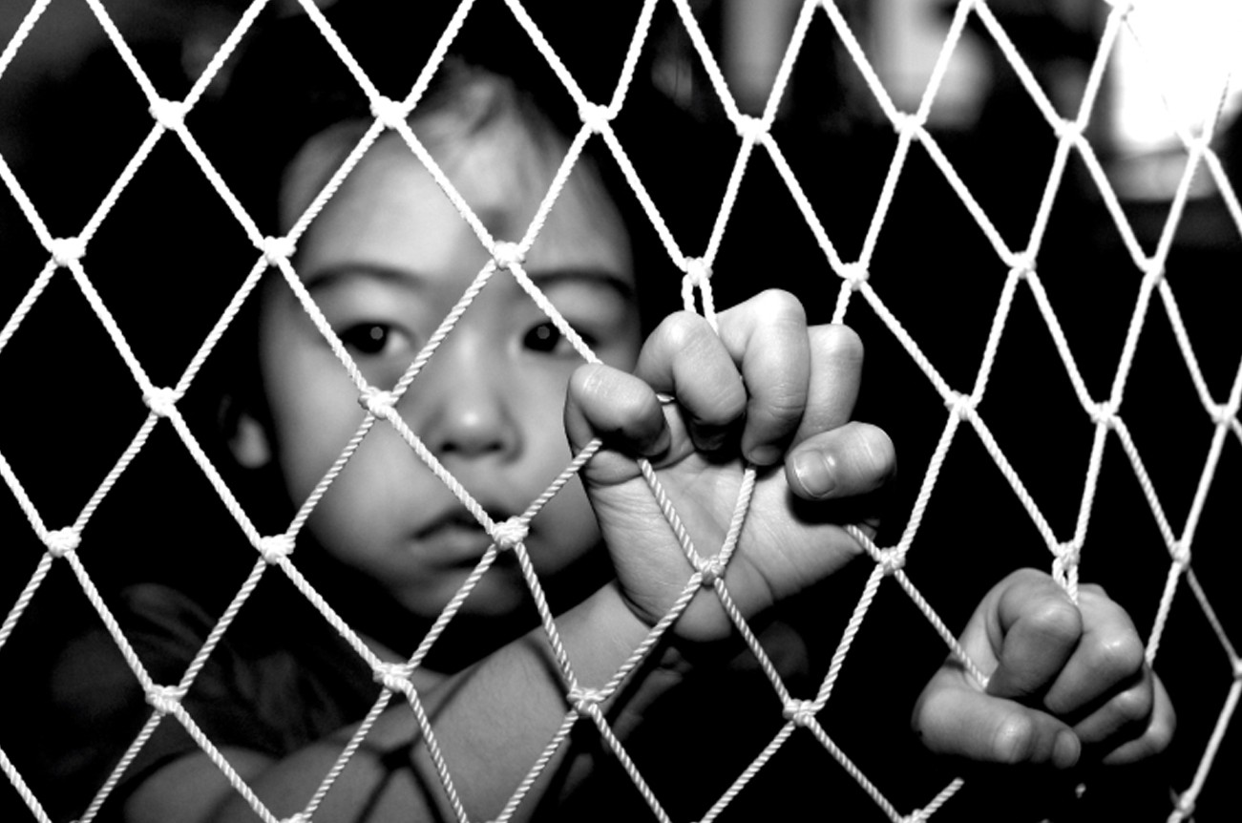
10 When he had seen the vision, immediately we sought to go into Macedonia, concluding that God had called us to preach the gospel to them.

Slide 46
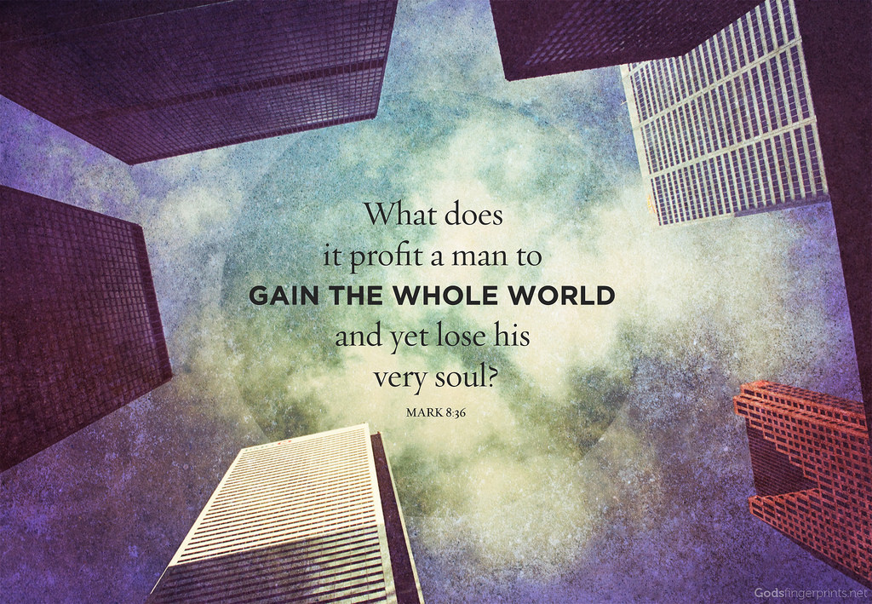

Slide 47
HOW DOES IT

Slide 48
Displaying the Worth of the Gospel
includes but is not limited to...
Trusting God Adventurously
Joyfully Receiving Course Corrections
Generously Meeting Needs Especially Eternal Needs

Slide 50
Phil 1:27
Only conduct yourselves in a manner worthy of the gospel of Christ

Slide 51
Displaying the Worth of the Gospel
includes but is not limited to...
Trusting God Adventurously
Joyfully Receiving Course Corrections
Generously Meeting Needs Especially Eternal Needs
Receiving Bright Moments of God's Providence
Demonstrating Routine Faithfulness
Receiving Dark Moments of God's Providence
Suffering for the Sake of Christ
Giving of Yourself Sacrificially for the progress of the Gospel

Slide 53
9 A vision appeared to Paul in the night: a man of Macedonia was standing and appealing to him, and saying, “Come over to Macedonia and help us.” 10 When he had seen the vision, immediately we sought to go into Macedonia, concluding that God had called us to preach the gospel to them.
11 So putting out to sea from Troas, we ran a straight course to Samothrace, and on the day following to Neapolis; 12 and from there to Philippi, which is a leading city of the district of Macedonia, a Roman colony; and we were staying in this city for some days. 13 And on the Sabbath day we went outside the gate to a riverside, where we were supposing that there would be a place of prayer; and we sat down and began speaking to the women who had assembled.
First Convert in Europe
14 A woman named Lydia, from the city of Thyatira, a seller of purple fabrics, a worshiper of God, was listening; and the Lord opened her heart to respond to the things spoken by Paul. 15 And when she and her household had been baptized, she urged us, saying, “If you have judged me to be faithful to the Lord, come into my house and stay.” And she prevailed upon us.

