Slide 1
Psalm 46
Be Still, Know God, and Fear Not
God, our Refuge and Strength, is with us!!!

Slide 2
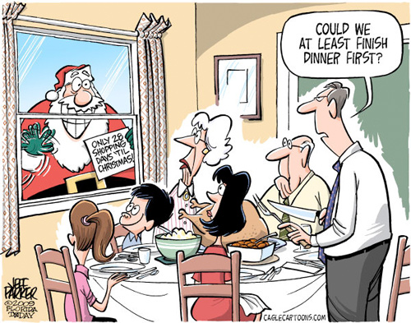

Slide 4
God is Our Refuge and Strength…
During Catastrophic Upheavals in Creation (vs 1-3)
During Staggering and Overwhelming Opposition (vs 4-7)
…Come! Behold our Victorious LORD of Hosts (vs 8-11)

Slide 5
God, our Refuge, During Catastrophic Upheavals in Creation
For the choir director. A Psalm of the sons of Korah, set to Alamoth. A Song.
1God is our refuge and strength,
A very present help in trouble.
2Therefore we will not fear, though the earth should change
And though the mountains slip into the heart of the sea;
3Though its waters roar and foam,
Though the mountains quake at its swelling pride. Selah.
E A R T H Q U A K E
T S U N A M I

Slide 6
Fukushima
March 11, 2011
Earthquake 9.0
Tsunami with waves up to 50 feet tall

Slide 10
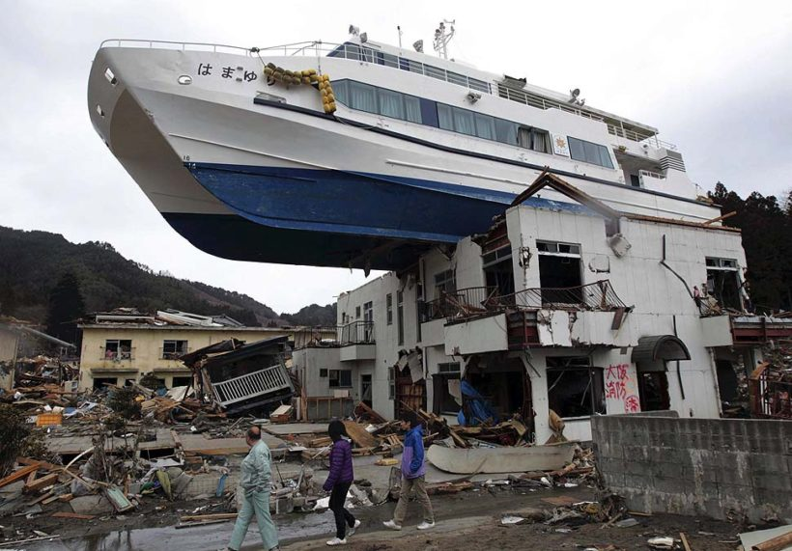

Slide 11
Our Refuge During Staggering Opposition
4There is a river whose streams make glad the city of God,
The holy dwelling places of the Most High.
5God is in the midst of her, she will not be moved;
God will help her when morning dawns.
6The nations made an uproar, the kingdoms tottered;
He raised His voice, the earth melted.
7The LORD of hosts is with us;
The God of Jacob is our stronghold. Selah.

Slide 12
God is Our Refuge and Strength…
During Catastrophic Upheavals in Creation (vs 1-3)
During Staggering and Overwhelming Opposition (vs 4-7)
…Come! Behold our Victorious LORD of Hosts (vs 8-11)

Slide 13
God is Our Refuge…
During Staggering and Overwhelming Opposition (vs 4-7)
SUGGESTED HISTORICAL BACKGROUND
The City of God (Jerusalem) under siege by the Assyrians and Sennacharib

Slide 14
Military Siege
A siege is a military blockade of a city or fortress with the intent of conquering by force or attrition, often accompanied by an assault. The term derives from the Latin word for "seat" or "sitting." A siege occurs when an attacker encounters a city or fortress that refuses to surrender and cannot be easily taken by a frontal assault. Sieges involve surrounding the target and blocking the reinforcement or escape of troops or provision of supplies, typically coupled with attempts to reduce the fortifications by means of siege engines, artillery bombardment, sapping (also known as mining), or the use of deception or treachery to bypass defenses. Failing a military outcome, sieges can often be decided by starvation, thirst or disease, which can afflict both the attacker or defender
Notes:
‹#›

Slide 15
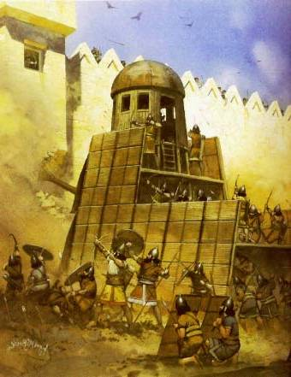

Slide 16
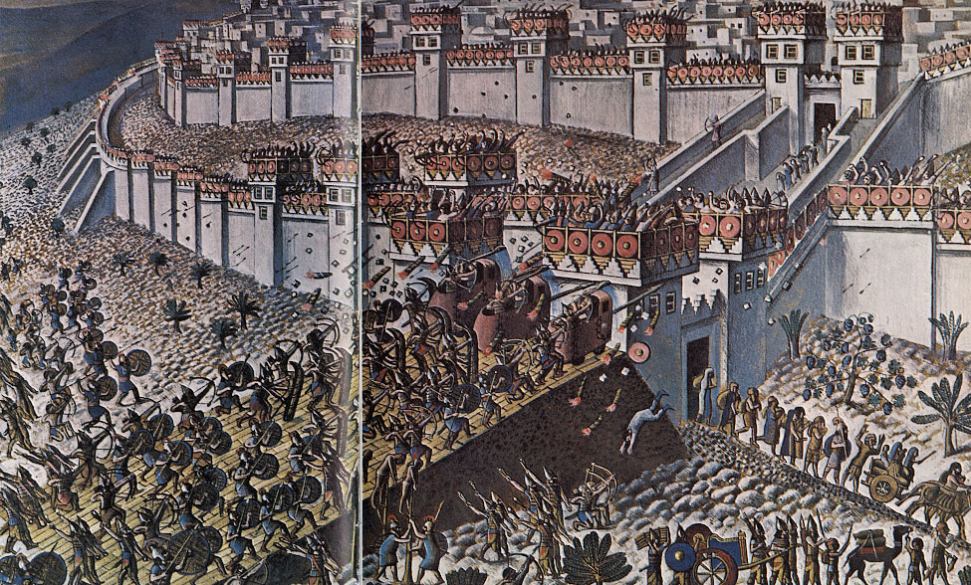

Slide 18
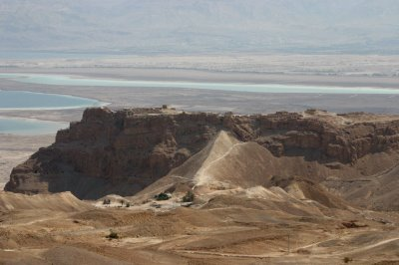
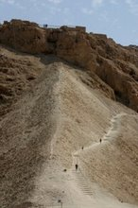

Slide 19
Psalm 46
Prism of Sennacherib
"As to Hezekiah, the Jew, he did not submit to my yoke, I laid siege to 46 of his strong cities, walled forts and to the countless small villages in their vicinity, and conquered [them] by means of well stamped [earth-]ramps and battering-rams… Himself I made a prisoner in Jerusalem, his royal residence, like a bird in a cage.”
Notes:
‹#›

Slide 20
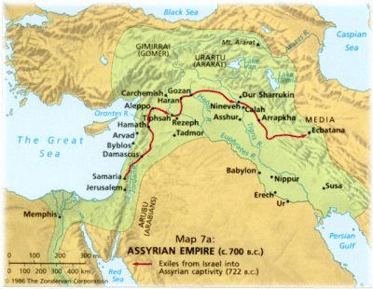
Psalm 46
Notes:
‹#›

Slide 21
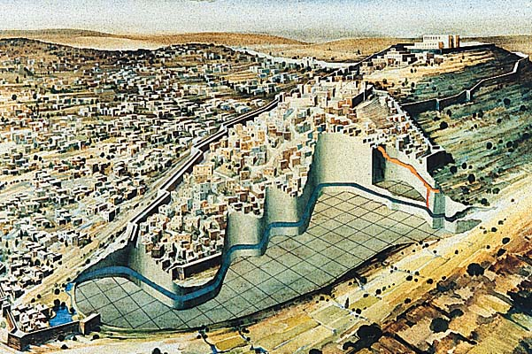
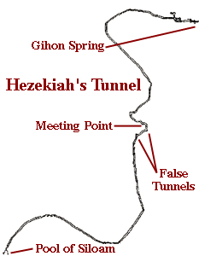
Psalm 46
…the inscription describes the meeting of the two groups of hewers who had begun digging from opposite ends of the tunnel. "The tunneling was completed... While the hewers wielded the ax, each man toward his fellow... there was heard a man's voice calling to his fellow... the hewers hacked each toward the other, ax against ax, and the water flowed from the spring to the pool, a distance of 1,200 cubits..."
Notes:
‹#›

Slide 22
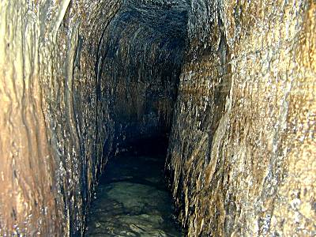
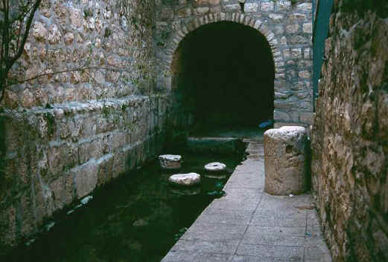
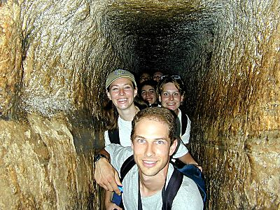
Psalm 46
Had it followed a straight line, the length would have been 1070 ft (335m) or 40% shorter.
A 1750-foot (530m) tunnel
Notes:
‹#›

Slide 23
God is Our Refuge…
During Staggering and Overwhelming Opposition (vs 4-7)
SUGGESTED HISTORICAL BACKGROUND
The City of God (Jerusalem) under siege by the Assyrians and Sennacharib
Isaiah 36 – 38
2 Kings 18 – 19
2 Chronicles 32

Slide 24
2 Kings 18:13-16
¹³Now in the fourteenth year of King Hezekiah, Sennacherib king of Assyria came up against all the fortified cities of Judah and seized them.
¹⁴Then Hezekiah king of Judah sent to the king of Assyria at Lachish, saying, "I have done wrong. Withdraw from me; whatever you impose on me I will bear." So the king of Assyria required of Hezekiah king of Judah three hundred talents of silver and thirty talents of gold.

Slide 25
2 Kings 18:13-16
¹⁵Hezekiah gave him all the silver which was found in the house of the LORD, and in the treasuries of the king's house.
¹⁶At that time Hezekiah cut off the gold from the doors of the temple of the LORD, and from the doorposts which Hezekiah king of Judah had overlaid, and gave it to the king of Assyria.

Slide 26
2 Chronicles 32:2-6
²Now when Hezekiah saw that Sennacherib had come and that he intended to make war on Jerusalem,
³he decided with his officers and his warriors to cut off the supply of water from the springs which were outside the city, and they helped him.
⁴So many people assembled and stopped up all the springs and the stream which flowed through the region, saying, "Why should the kings of Assyria come and find abundant water?"

Slide 27
2 Chronicles 32:2-6
⁵And he took courage and rebuilt all the wall that had been broken down and erected towers on it, and built another outside wall and strengthened the Millo in the city of David, and made weapons and shields in great number.
⁶He appointed military officers over the people and gathered them to him in the square at the city gate, and spoke encouragingly to them, saying,

Slide 28
2 Chronicles 32:7-8
⁷"Be strong and courageous, do not fear or be dismayed because of the king of Assyria nor because of all the horde that is with him; for the one with us is greater than the one with him.
⁸"With him is only an arm of flesh, but with us is the LORD our God to help us and to fight our battles." And the people relied on the words of Hezekiah king of Judah.

Slide 29
2 Kings 18:17-20
¹⁷Then the king of Assyria sent Tartan and Rab-saris and Rabshakeh from Lachish to King Hezekiah with a large army to Jerusalem So they went up and came to Jerusalem And when they went up, they came and stood by the conduit of the upper pool, which is on the highway of the fuller's field.
¹⁸When they called to the king, Eliakim the son of Hilkiah, who was over the household, and Shebnah the scribe and Joah the son of Asaph the recorder, came out to them.

Slide 30
2 Kings 18:17-20
¹⁹Then Rabshakeh said to them, "Say now to Hezekiah, 'Thus says the great king, the king of Assyria, "What is this confidence that you have?
²⁰"You say (but they are only empty words), 'I have counsel and strength for the war.' Now on whom do you rely, that you have rebelled against me?

Slide 31
2 Kings 18:21-24
²¹"Now behold, you rely on the staff of this crushed reed, even on Egypt; on which if a man leans, it will go into his hand and pierce it. So is Pharaoh king of Egypt to all who rely on him.
²²"But if you say to me, 'We trust in the LORD our God,' is it not He whose high places and whose altars Hezekiah has taken away, and has said to Judah and to Jerusalem, 'You shall worship before this altar in Jerusalem'?

Slide 32
2 Kings 18:21-24
²³"Now therefore, come, make a bargain with my master the king of Assyria, and I will give you two thousand horses, if you are able on your part to set riders on them.
²⁴"How then can you repulse one official of the least of my master's servants, and rely on Egypt for chariots and for horsemen?

Slide 33
2 Kings 18:25-30
²⁵"Have I now come up without the LORD'S approval against this place to destroy it? The LORD said to me, 'Go up against this land and destroy it.'"'"
²⁶Then Eliakim the son of Hilkiah, and Shebnah and Joah, said to Rabshakeh, "Speak now to your servants in Aramaic, for we understand it; and do not speak with us in Judean in the hearing of the people who are on the wall."

Slide 34
2 Kings 18:25-30
²⁷But Rabshakeh said to them, "Has my master sent me only to your master and to you to speak these words, and not to the men who sit on the wall, doomed to eat their own dung and drink their own urine with you?"
²⁸Then Rabshakeh stood and cried with a loud voice in Judean, saying, "Hear the word of the great king, the king of Assyria.

Slide 35
2 Kings 18:25-30
²⁹"Thus says the king, 'Do not let Hezekiah deceive you, for he will not be able to deliver you from my hand;
³⁰nor let Hezekiah make you trust in the LORD, saying, "The LORD will surely deliver us, and this city will not be given into the hand of the king of Assyria."

Slide 36
2 Kings 18:31-35
³¹'Do not listen to Hezekiah, for thus says the king of Assyria, "Make your peace with me and come out to me, and eat each of his vine and each of his fig tree and drink each of the waters of his own cistern,
³²until I come and take you away to a land like your own land, a land of grain and new wine, a land of bread and vineyards, a land of olive trees and honey, that you may live and not die." But do not listen to Hezekiah when he misleads you, saying, "The LORD will deliver us."

Slide 37
2 Kings 18:31-35
³³'Has any one of the gods of the nations delivered his land from the hand of the king of Assyria?
³⁴'Where are the gods of Hamath and Arpad? Where are the gods of Sepharvaim, Hena and Ivvah? Have they delivered Samaria from my hand?
³⁵'Who among all the gods of the lands have delivered their land from my hand, that the LORD should deliver Jerusalem from my hand?'"

Slide 38
2 Kings 18:36-19:2
³⁶But the people were silent and answered him not a word, for the king's commandment was, "Do not answer him."
³⁷Then Eliakim the son of Hilkiah, who was over the household, and Shebna the scribe and Joah the son of Asaph, the recorder, came to Hezekiah with their clothes torn and told him the words of Rabshakeh.

Slide 39
2 Kings 18:36-19:2
¹And when King Hezekiah heard it, he tore his clothes, covered himself with sackcloth and entered the house of the LORD.
²Then he sent Eliakim who was over the household with Shebna the scribe and the elders of the priests, covered with sackcloth, to Isaiah the prophet the son of Amoz.

Slide 40
2 Kings 19:3-5
³They said to him, "Thus says Hezekiah, 'This day is a day of distress, rebuke, and rejection; for children have come to birth and there is no strength to deliver.
⁴'Perhaps the LORD your God will hear all the words of Rabshakeh, whom his master the king of Assyria has sent to reproach the living God, and will rebuke the words which the LORD your God has heard Therefore, offer a prayer for the remnant that is left.'"
⁵So the servants of King Hezekiah came to Isaiah.

Slide 41
2 Kings 19:10-13
¹⁰"Thus you shall say to Hezekiah king of Judah, 'Do not let your God in whom you trust deceive you saying, "Jerusalem will not be given into the hand of the king of Assyria."
¹¹'Behold, you have heard what the kings of Assyria have done to all the lands, destroying them completely. So will you be spared?

Slide 42
2 Kings 19:10-13
¹²'Did the gods of those nations which my fathers destroyed deliver them, even Gozan and Haran and Rezeph and the sons of Eden who were in Telassar?
¹³'Where is the king of Hamath, the king of Arpad, the king of the city of Sepharvaim, and of Hena and Ivvah?'"

Slide 43
2 Kings 19:14-16
¹⁴Then Hezekiah took the letter from the hand of the messengers and read it, and he went up to the house of the LORD and spread it out before the LORD.
¹⁵Hezekiah prayed before the LORD and said,

Slide 44
2 Kings 19:14-16
"O LORD, the God of Israel, who are enthroned above the cherubim, You are the God, You alone, of all the kingdoms of the earth. You have made heaven and earth.
¹⁶"Incline Your ear, O LORD, and hear; open Your eyes, O LORD, and see; and listen to the words of Sennacherib, which he has sent to reproach the living God.

Slide 45
2 Kings 19:17-19
¹⁷"Truly, O LORD, the kings of Assyria have devastated the nations and their lands
¹⁸and have cast their gods into the fire, for they were not gods but the work of men's hands, wood and stone. So they have destroyed them.
¹⁹"Now, O LORD our God, I pray, deliver us from his hand that all the kingdoms of the earth may know that You alone, O LORD, are God."

Slide 46
2 Kings 19:20-22
²⁰Then Isaiah the son of Amoz sent to Hezekiah saying, "Thus says the LORD, the God of Israel, 'Because you have prayed to Me about Sennacherib king of Assyria, I have heard you.'
²¹"This is the word that the LORD has spoken against him:

Slide 47
2 Kings 19:20-22
'She has despised you and mocked
you, The virgin daughter of Zion; She has shaken her head behind
you, The daughter of Jerusalem! ²² ' Whom have you reproached
and blasphemed? And against whom have you raised
your voice, And haughtily lifted up your eyes? Against the Holy One of Israel!

Slide 48
2 Kings 19:23-25
²³'Through your messengers you have reproached the Lord, And you have said, "With my many chariots I came up to the heights of the mountains, To the remotest parts of Lebanon; And I cut down its tall cedars and its choice cypresses And I entered its farthest lodging place, its thickest forest.

Slide 49
2 Kings 19:23-25
²⁴"I dug wells and drank foreign waters, And with the sole of my feet I dried
up All the rivers of Egypt."
²⁵'Have you not heard? Long ago I did it; From ancient times I planned it Now I have brought it to pass, That you should turn fortified cities
into ruinous heaps.

Slide 50
2 Kings 19:26-27
²⁶'Therefore their inhabitants were short of strength, They were dismayed and put to shame; They were as the vegetation of the field and as the green herb, As grass on the housetops is scorched before it is grown up. ²⁷'But I know your sitting down, And your going out and your coming in, And your raging against Me.

Slide 51
2 Kings 19:28
²⁸'Because of your raging against Me, And because your arrogance has come up to My ears, Therefore I will put My hook in your nose, And My bridle in your lips, And I will turn you back by the way which you came.

Slide 52
2 Kings 19:29-34
²⁹'Then this shall be the sign for you: you will eat this year what grows of itself, in the second year what springs from the same, and in the third year sow, reap, plant vineyards, and eat their fruit.
³⁰'The surviving remnant of the house of Judah will again take root downward and bear fruit upward.
³¹'For out of Jerusalem will go forth a remnant, and out of Mount Zion survivors The zeal of the LORD will perform this.

Slide 53
2 Kings 19:29-34
³²'Therefore thus says the LORD concerning the king of Assyria, "He will not come to this city or shoot an arrow there; and he will not come before it with a shield or throw up a siege ramp against it.
³³"By the way that he came, by the same he will return, and he shall not come to this city,"' declares the LORD.
³⁴'For I will defend this city to save it for My own sake and for My servant David's sake.'"

Slide 54
2 Kings 19:35-37
³⁵Then it happened that night that the angel of the LORD went out and struck 185,000 in the camp of the Assyrians; and when men rose early in the morning, behold, all of them were dead.
³⁶So Sennacherib king of Assyria departed and returned home, and lived at Nineveh.
³⁷It came about as he was worshiping in the house of Nisroch his god, that Adrammelech and Sharezer killed him with the sword; and they escaped into the land of Ararat And Esarhaddon his son became king in his place.

Slide 55
Our Refuge During Staggering Opposition
4There is a river whose streams make glad the city of God,
The holy dwelling places of the Most High.
5God is in the midst of her, she will not be moved;
God will help her when morning dawns.
6The nations made an uproar, the kingdoms tottered;
He raised His voice, the earth melted.
7The LORD of hosts is with us;
The God of Jacob is our stronghold. Selah.
Notes:
‹#›

Slide 56
God is Our Refuge…
During Catastrophic Upheavals in Creation (vs 1-3)
During Staggering and Overwhelming Opposition (vs 4-7)
…Come! Behold our Victorious LORD of Hosts (vs 8-11)

Slide 57
Our Refuge Come Behold our Victorious LORD of Hosts
8Come, behold the works of the LORD,
Who has wrought desolations in the earth.
9He makes wars to cease to the end of the earth;
He breaks the bow and cuts the spear in two;
He burns the chariots with fire.
10"Cease striving and know that I am God;
I will be exalted among the nations, I will be exalted in the earth."
11The LORD of hosts is with us;
The God of Jacob is our stronghold. Selah.

Slide 58
Psalm 46
Who or what is your refuge and strength when these things are in turmoil?
Finances Safety Plans and Schedule Health Friends/Family | Children Reputation Food Shelter/Clothes Job
Especially your eternal soul

Slide 59
What are you going to do?
When your health is gone?
If you lose your job?
If Social Security fails?
If our economy fails?
If your spouse or kids die?
If there is an earthquake?
When you stand before a Holy God as a sinner?
When your sin is exposed?

Slide 60
Psalm 46
Who or what do you want with you when you need help or protection?
Are God and His promises your comfort zone or is it someone or something far less than He?
If Yahweh of Hosts is your refuge, your strength, your help, and is with you, do you not have exceedingly sufficient cause to rejoice, to sing, and to love God more, no matter what the circumstance?
Notes:
‹#›

Slide 61
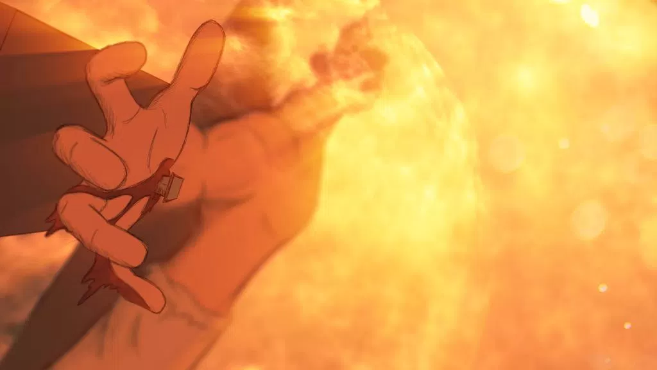

Slide 62
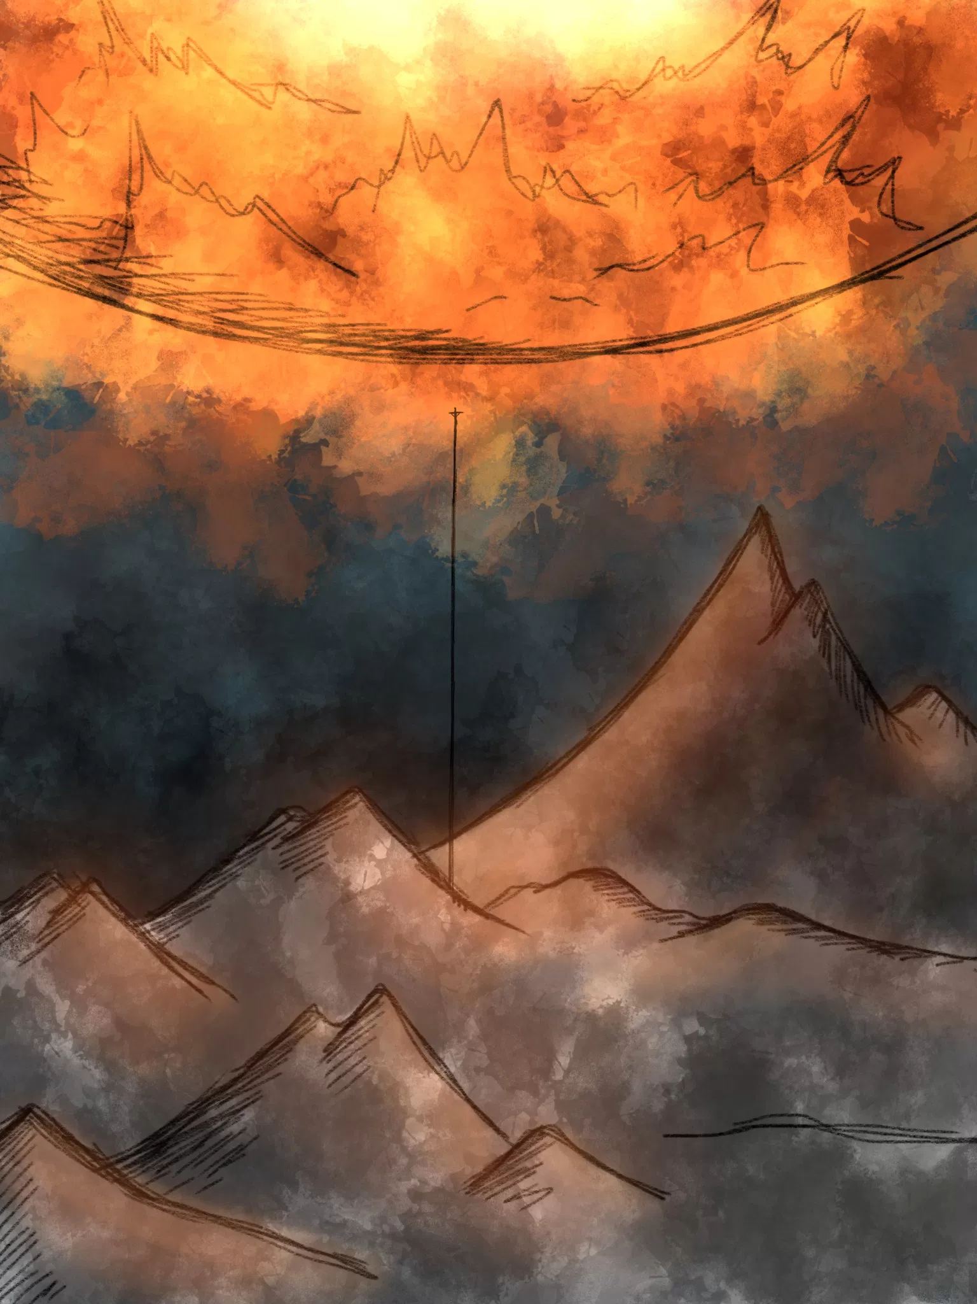
God is our refuge and strength, A very present help in trouble. 2 Therefore we will not fear, though the earth should change And though the mountains slip into the heart of the sea; 3 Though its waters roar and foam, Though the mountains quake at its swelling pride. Selah.

Slide 64
Hebrews 13:5...for He Himself has said, “I will never desert you, nor will I ever forsake you,” 6 so that we confidently say, “The Lord is my helper, I will not be afraid. What will man do to me?”
Psalm 46
God is our refuge and strength, A very present help in trouble.
John 14:16 I will ask the Father, and He will give you another Helper, that He may be with you forever;17 that is the Spirit of truth

Slide 65
Matthew 1:23 “Behold, the virgin shall be with child and shall bear a Son, and they shall call His name Immanuel,” which translated means, “God with us.”
Psalm 46
The Lord of hosts is with us; The God of Jacob is our stronghold. Selah.
Matthew 28:20 teaching them to observe all that I commanded you; and lo, I am with you always, even to the end of the age.

Slide 66
A Mighty Fortress is Our God
A mighty fortress is our God, a bulwark never failing;
Our helper He, amid the flood of mortal ills prevailing:
For still our ancient foe doth seek to work us woe;
His craft and pow’r are great, and, armed with cruel hate,
On earth is not his equal.

Slide 67
The Solid Rock
His oath, His covenant, His blood
Support me in the whelming flood;
When all around my soul gives way,
He then is all my hope and stay.
Refrain:
On Christ, the solid Rock, I stand;
All other ground is sinking sand,
All other ground is sinking sand.

Slide 68
The Unbelievable
Lord, we’re lost in overwhelming awe
At the thought of such amazing love
God has come, God has come
God has come to dwell with us

Slide 69
Psalm 46
Be Still, Know God, and Fear Not
God is our Refuge and Strength!
Yahweh of Host is With Us!
Notes:
‹#›

